Slide 1
Text

Slide 2
Table of Content
Introduction of text.
Text elements.
Types of text.
Fonts and typefaces.
Font Terminology.
Classification of fonts.
Font styles.
Font types.
Bitmapped and Vector fonts.
Font appearance.
Font mapping.
Guidelines of choosing fonts.
Efficient use of text.

Slide 3
Introduction
Text is obviously the simplest of data types and requires the least amount of storage.
Text in the form of words, sentences, and paragraphs is used to communicate thoughts, ideas, and facts in daily life.
Text may not be as visually exciting as some of the other media types, but it often conveys essential and precise information.

Slide 4
…continued
Multimedia applications depend on text for many things including:
  Page titles
  Delivering information in form of multiple sentences / paragraphs
  Labels for pictures
  Instructions for operating the application
Text is probably the most common form of information delivery.

Slide 5
Text elements
Alphabet characters
  A – Z and a – z
Numbers
  0 – 9
Special characters
  Punctuation (. , ; “ ‘ ! : - /)
  Signs ($ + - = @ # % ^ & *)

Slide 6
Obtaining Text
Text can be captured in following ways:
  Keyboard
  Mouse
  Scanner (OCR) – Optical Character Recognization*
    * designed to translate images of handwritten or typewritten text (usually captured by a scanner) into machine-editable text.

Slide 7
Types of Text
Unformatted text (Plaintext)
  comprise strings of fixed-sized characters from a limited character set.
Formatted text (Richtext)
  comprise strings of characters of different styles, size and shape together with tables, graphics and image inserted at appropriate point.
  Example: Rich Text Format (RTF), HTML, .doc

Slide 8
Types of Text
Hypertext
It enables the integrated set of documents (each comprising formatted text) to be created which have defined linkages between them.

Slide 9
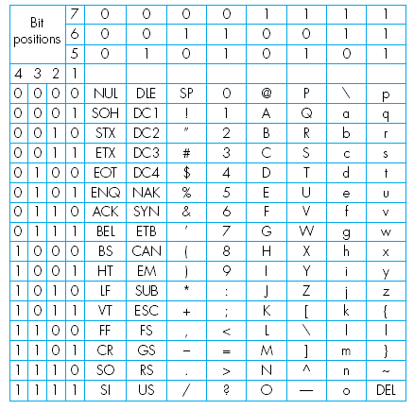
Unformatted Text
This is a set of characters that are available in the ASCII (American Standard Code for Information Interchange) character set. This is one of the most widely used character sets and the table includes the binary codeword used to represent each character.
Basic ASCII character set

Slide 10
ASCII Code
ASCII Code
Each character is represented by a unique 7-bit binary codeword, meaning that there are 128 (2⁷) alternative characters.
In addition to all normal alphabetic, numeric and punctuation characters, the total ASCII character set also includes control characters such as BS (backspace), DEL (delete), etc.

Slide 11
…continued
Unicode
  Unicode is the universal standard for multi language characters published by Unicode Consortium.
  Unicode 4.0 standard covers 96,382 characters using 16 bits uniform encoding.
  Unicode can support a wide variety of non-Roman alphabets including Han Chinese, Japanese, Arabic, Korean, Bengali, and so on.
Unicode
Characters
ﺍﺏﺙﺚﺝﺡﺥ
αβγδεζ

Slide 12
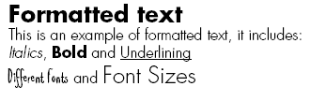
Formatted Text
An example of formatted text is that produced by most word processing packages. It enables documents to be created that consist of characters of different styles and variable size and shape, each of which can be plain, bold, or italicized.
In addition, a variety of document formatting options are supported to enable an author to structure a document into chapters, sections and paragraphs, each of which with different headings and with tables, graphics and pictures inserted at appropriate points.

Slide 13
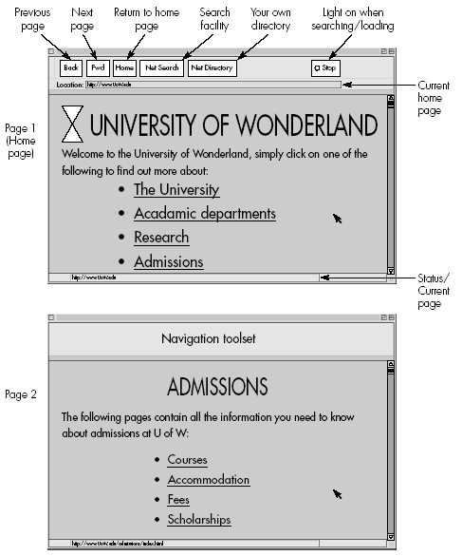
Hypertext
Hypertext is a type of formatted text that enables a related set of documents, normally referred to as pages, to be created which have defined linkage points, referred to as hyperlinks, between each other.
Figure 2.3. Example of an electronic
Document written in hypertext

Slide 14
Fonts & Typefaces
Font
  Collection of characters of different sizes and styles of a typeface.
  Example : Arial 18 point Bold
Typeface
  Graphic representation or the shape of characters.
  A typeface is a family of related fonts
  Example : Bookman Old Style

Slide 15
Font Terminology
337
Baseline – the line on which the bases of characters are arranged
Leading – the distance between successive baselines
x-height – the distance between the baseline and the top of a lower-case letter x
Ascenders/descenders – strokes that rise above the x-height/drop below the baseline
Kerning – adjustment of space between certain pairs of letters (e.g. AV) to make them look more uniform

Slide 16
Font Terminology
  Tracking - Spacing between characters.
  Serif - Flag or decoration at the end of a character stroke.

Slide 17
Classification of Fonts
327–330
Spacing: monospaced (fixed width)/proportional
Serifs: serifed/sans serif
  Serifs are the small strokes added to the ends of character
  shapes in conventional book fonts
Shape: upright/italic/slanted
  Slant is a vertical shear effect, italic uses different glyph shapes
  with a slant
Weight: bold/normal/light

Slide 18
This example shows the Times New Roman font
Ascender
Cap height
X-height
FD xhp
Point size
Serif
Baseline
Descender

Slide 19
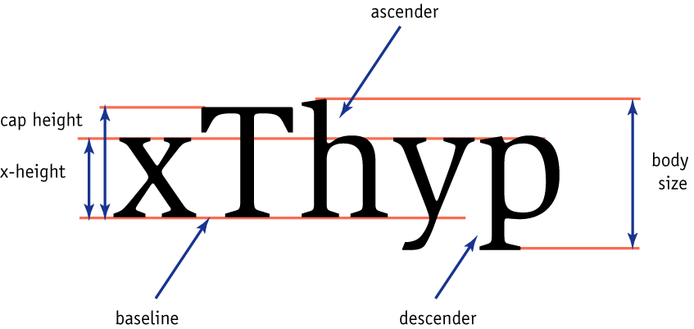
336

Slide 20
BD hp
Av
Reading line one.
Reading line two.
Serif
Tracking
Ascender
Kerning
Descender
Leading

Slide 21
Tracking and Kerning
Tight
tracking
Loose
tracking
Av
A
v
Unkerned
Kerned

Slide 22
Serif and sans serif fonts
Fonts can broadly be said to be of one of two types: serif or sans serif
A serif is the decorative ‘bit’ at the end of a letter stroke
  Serif fonts have them and sans serif fonts don’t (‘sans’ being French for ‘without’)
Serif fonts are usually used for printed media or documents that have large quantities of text.
  This is because the serif helps guide the reader’s eye along the line
Sans Serif fonts are considered better for computer displays because of the sharper contrast.

Slide 23
Serif fonts
Sans serif fonts
Times New Roman
Bookman Old Style
Monotype Corsiva
Courier New
Arial
Tahoma
Impact
Verdana

Slide 24
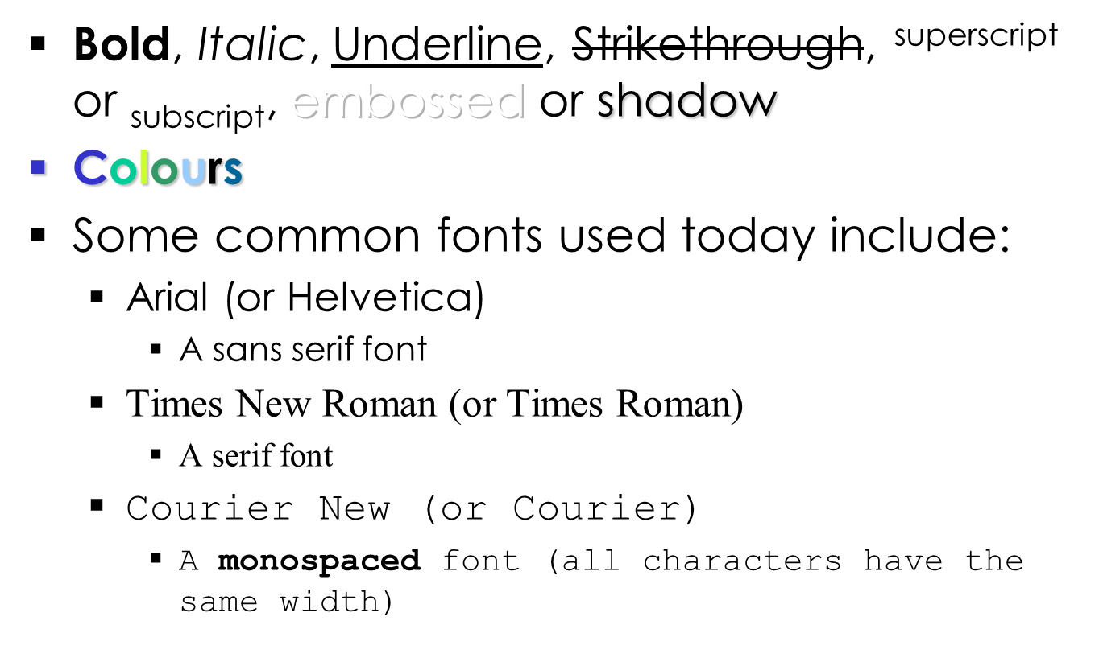
Font Styles

Slide 25
Font Types
PostScript
  Page Description Language
  Uses mathematical construct
  Allows the character to be scaled bigger/smaller; able to be finely printed.
  Needs special software to display
  Needs licensing
  Example: Adobe’s PostScript
TrueType
  Page Description Language
  TrueType is joint effort by Apple & Microsoft.
  Uses mathematical construct.
  In addition to printing smooth chars, it allows chars displayed on low-resolution monitors.
  No special software needed to display
  No licensing needed
Bitmap
  Images of characters
  Requires a lot of memory

Slide 26
Bitmapped and vector fonts
Fonts can either be stored as bitmapped or vector
Bitmaps require one bitmap for each size
  File size increases as more sizes are added.
  Require a lot of memory.
Vector fonts can draw any size by scaling the vector drawing primitives mathematically
  File size is much smaller than bitmaps.
  TrueType and PostScript are vector font formats.

Slide 27
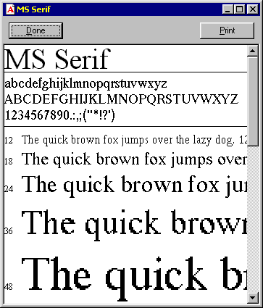
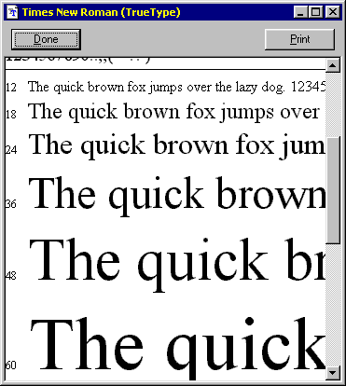
Bitmapped and vector fonts
A bitmapped font
A vector font

Slide 28

Font Appearance
Rasterization
Taking an image in described in a vector graphics format(shapes) and converting it into a raster image(pixels or dots)
Font is drawn on the screen one pixel at a time
Jaggies are the jagged edges you see when a bitmapped image is resized
It is a consequence of the underlying array of pixels from which the image is composed

Slide 29

Font Appearance contd..
Anti-aliasing
  Blend the font into the background color.
  This technique minimizes the jagged edges making for smoother overall appearance.
  It substitutes additional pixels in other colours to fool the brain into thinking it is seeing continuous lines

Slide 30
Font mapping
Some fonts installed in your machine may not be available in other user’s machine.
If the fonts that you used is not available in other people’s computer, a default font will be used for substitution.
Specifying which font to be substitution is called font mapping.

Slide 31
CAN YOU READ THIS? IF NOT IT IS BECAUSE EVERYTHING IS WRITTEN IN CAPITAL LETTERS. THEREFORE THIS SHOULD ALWAYS BE AVOIDED.
Can you read this? It is easier because people will recognize shape of characters easier this way.
Can you read this? It is easier because people will recognize shape of characters easier this way.

Slide 32
Meaningful words
Text is use for titles and headlines, menus, navigation, and content.
Too much text – crowded or ‘busy’ screen
Too little text – too many page
Words must be chosen carefully

Slide 33
Guideline of choosing fonts
For small type, do not use decorative fonts because in small size they are unreadable.
Use as few typefaces as possible but you can vary the size and style using italic or bold.
Adjust the leading or line spacing where you have a lot of text for easier reading.
Vary the size of a font according to the importance of the message you are delivering.
Use bold or emphasize text to highlight ideas or concept.

Slide 34
Guideline of choosing fonts
In large headlines, adjust the spacing between letters (kerning) so that the spacing feels right.
Use anti-aliasing for big fonts but turn off anti-aliasing for small fonts.
Surround headlines with white space
Distinguish text links with colors and underlining
Use drop caps and initial caps

Slide 35
Efficient use of text
Positive ways to communicate message by less text and other ways are
  Hypertext
  Pop-up Messages
  Drop-down Boxes
  Scroll Bars
  Buttons for interaction
  Symbols & Icons

Slide 36
Hypertext
Linking a hypertext or hot word / hotspot to another part of the title that displays more text
Very effectively used to retrieve info from databases
Helps user in decision making
User can process information faster and strategically

Slide 37
Pop-up messages
Another type of Hot word used to save space
Click on a hot word or a text, a small message pops up explaining in brief about the hot word
Remains for some time and vanishes after programmed duration or by a mouse click

Slide 38
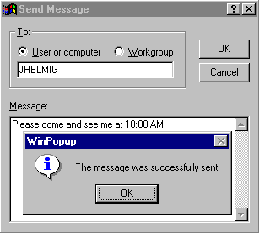
Pop-up messages contd..

Slide 39
Drop-down boxes
Gives the user a set of choices and reduces his strain of decision making
That is making choice in a easier way and limited according to the system’s capabilities
Choosing may lead to another page with text or may retrieve info from database

Slide 40
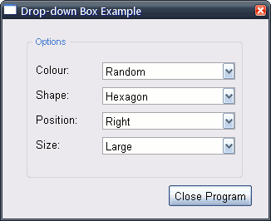
Drop-down boxes contd..

Slide 41
Scroll Bars
Usually not a good practice to use scroll bars
Mostly irritates the user
Important messages should not be posted using scrollbars, since the user may not notice it

Slide 42
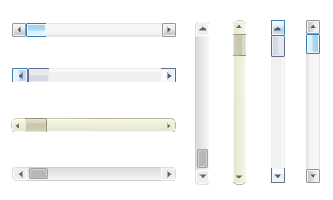
Scroll Bars contd..

Slide 43
Buttons
The concept of hyper linking remains the same
Change in appearance by using a button with text to glow on it rather than using a hyper text

Slide 44
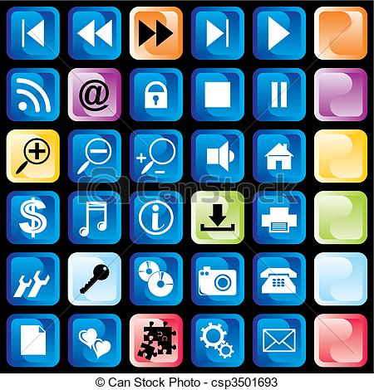
Buttons contd..

Slide 45
Symbols & Icons
Using symbols or icons in-order to express a meaning
Easier to learn and remember than commands
Eg: A floppy icon in MS Word represents “Save”, expressing to save the document
Tools(e.g. paintbrush), applications(web bowsers), and operations(cut, paste, next, accept, change)

Slide 46
Summary
Text is the simplest of data types and requires the least amount of storage.
3 categories of text elements:
Alphabet characters, Numbers, Special characters
3 types of text:
Unformatted text, Formatted text, Hypertext
Font is the collection of characters of different sizes and styles of a typeface.
Typeface is the graphic representation or the shape of characters.
Font Terminology:
Baseline, Leading, x-height, Ascenders/ Descenders, Kerning, Tracking, Serif
Classification of fonts:
Spacing, Serifs, Shape, Weight

Slide 47
Summary
Font types:
PostScript, TrueType, Bitmap
9. Bitmaps require one bitmap for each size.
  File size increases as more sizes are added.
  Require a lot of memory.
Vector fonts can draw any size by scaling the vector drawing
primitives mathematically.
  File size is much smaller than bitmaps.
  Rasterization refers that font is drawn on the screen one pixel at a
  time.
  Anti-aliasing blends the font into the background colour to
  minimize the jagged edges making for smoother overall appearance.

Slide 48
Summary
Font mapping specifies which font to be substitution if the
fonts that you used is not available in other people’s computer.
14. Positive ways to communicate message by less text:
Hypertext, Pop-up Messages, Drop-down Boxes,
  Scroll Bars, Buttons, Symbols & Icons.

